Slide 1


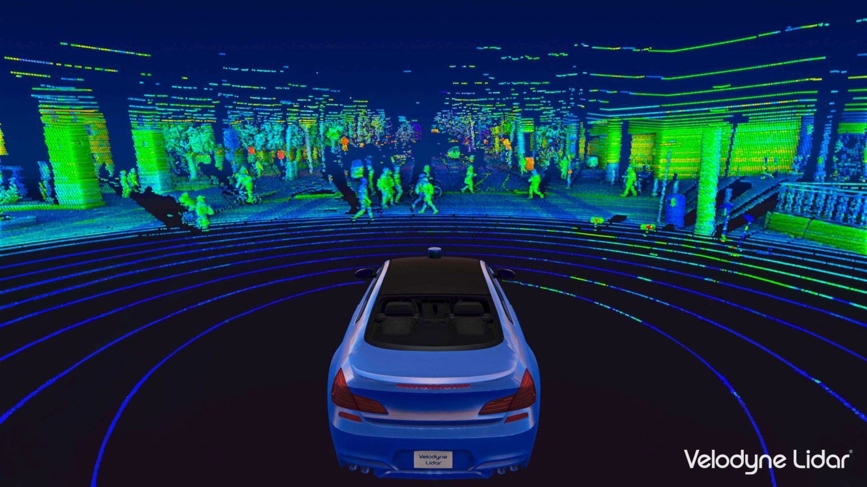


Object detection with LiDAR
Presented by Luis Rodriguez

Slide 2
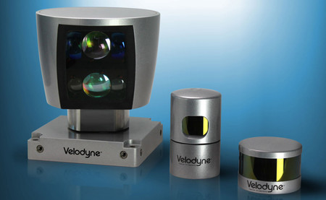
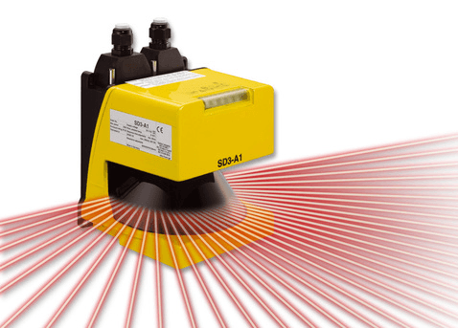
What is a Lidar ?
Lidar (light detection and ranging) is sometimes called “laser scanning” or “3D scanning.” The technology uses eye-safe laser beams to create a 3D representation of the surveyed environment.

Slide 3

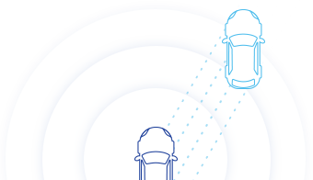
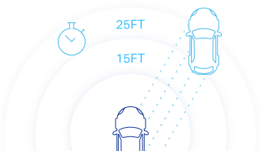
How does it work?
Lidar sensor emits pulsed light waves into the surrounding environment.
These pulses bounce off surrounding objects and return to the sensor.
The sensor uses the time it took for each pulse to return to the sensor to calculate the distance it traveled.

Slide 4
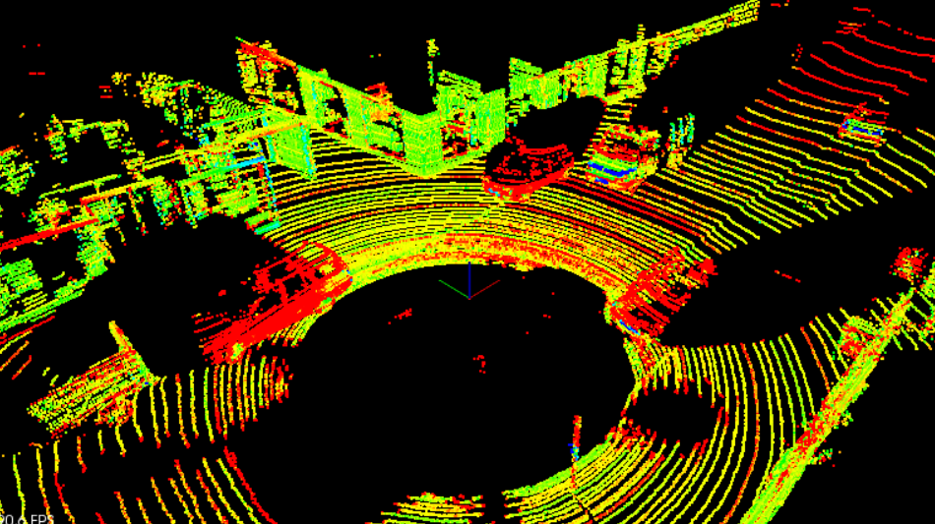
WhAT IS A POINT CLOUD?
Lidar data is stored in a format called Point Cloud Data (PCD for short). A .pcd file is a list of (x,y,z) cartesian coordinates along with intensity values, it’s a single snapshot of the environment, so after a single scan.

Slide 5
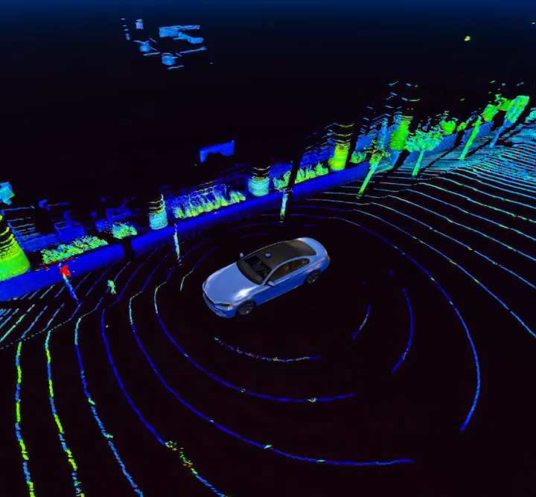
STEPS TO DECTECT OBJECTS
Preprocessing
Segmentation
Clustering

Slide 6
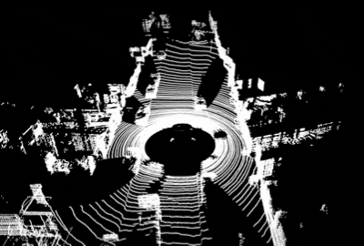
Preprocessing
We can use FilterCLoud()

Slide 7
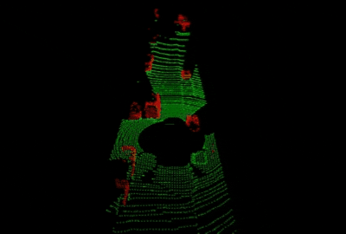
Segmentation
We use this method to group connected that integrate a group.
In PCL (Point Cloud Library) we can use function SegmentPlane()
It results on creating two point clouds: obstacles and road.

Slide 8
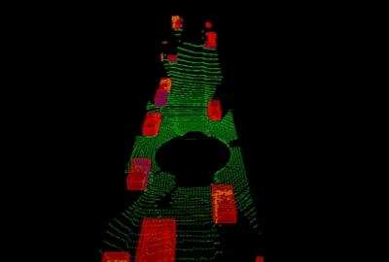
clustering
A clustering method needs to divide an unorganized point cloud model into smaller parts

